Slide 1
Brief History of Python
Invented in the Netherlands, early 90s by Guido van Rossum
Named after Monty Python
Open sourced from the beginning
Considered a scripting language, but is much more
Scalable, object oriented and functional from the beginning
Used by Google from the beginning
Increasingly popular

Slide 2

Python’s Benevolent Dictator For Life
“Python is an experiment in how much freedom program-mers need. Too much freedom and nobody can read another's code; too little and expressive-ness is endangered.”
- Guido van Rossum

Slide 3
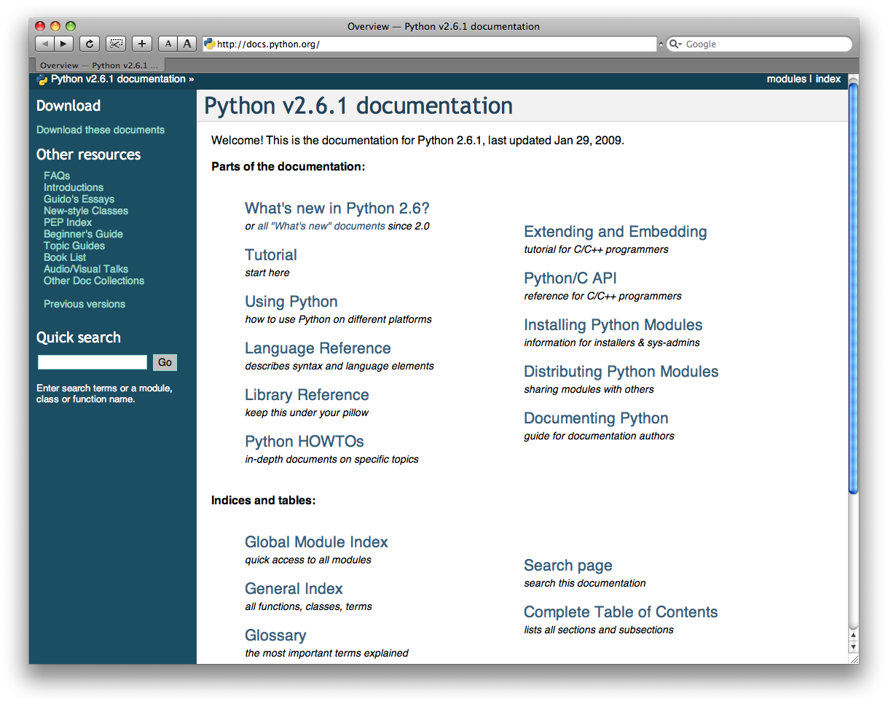
http://docs.python.org/

Slide 4

Running Python

Slide 5
The Python Interpreter
Typical Python implementations offer
both an interpreter and compiler
Interactive interface to Python with a
read-eval-print loop
    [finin@linux2 ~]$ python
    Python 2.4.3 (#1, Jan 14 2008, 18:32:40)
    [GCC 4.1.2 20070626 (Red Hat 4.1.2-14)] on linux2
    Type "help", "copyright", "credits" or "license" for more information.
    >>> def square(x):
    ... return x * x
    ...
    >>> map(square, [1, 2, 3, 4])
    [1, 4, 9, 16]
    >>>

Slide 6
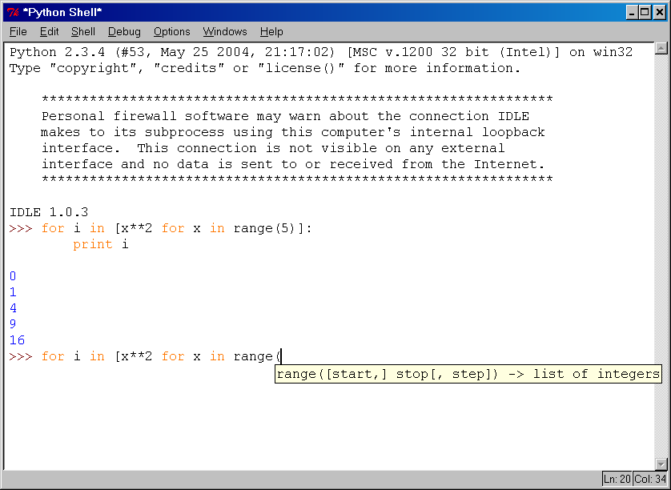
IDLE Development Environment
IDLE is an Integrated DeveLopment Environ-ment for Python, typically used on Windows
Multi-window text editor with syntax highlighting, auto-completion, smart indent and other.
Python shell with syntax highlighting.
Integrated debugger
with stepping, persis-
tent breakpoints,
and call stack visi-
bility

Slide 7
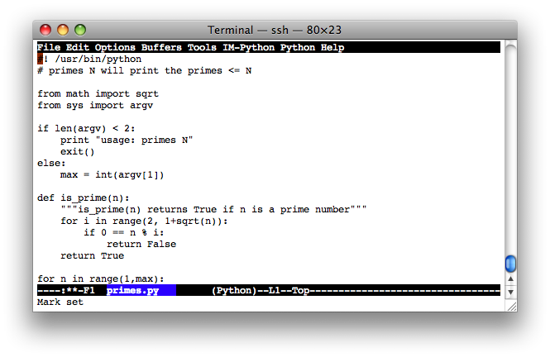
Editing Python in Emacs
Emacs python-mode has good support for editing Python, enabled enabled by default for .py files
Features: completion, symbol help, eldoc, and inferior interpreter shell, etc.

Slide 8
Example ‘script’: fact.py
#! /usr/bin/python
def fact(x):
"""Returns the factorial of its argument, assumed to be a posint"""
if x == 0:
return 1
return x * fact(x - 1)
print
print ’N fact(N)’
print "---------"
for n in range(10):
print n, fact(n)

Slide 9
Python Scripts
When you call a python program from the command line the interpreter evaluates each expression in the file
Familiar mechanisms are used to provide command line arguments and/or redirect input and output
Python also has mechanisms to allow a python program to act both as a script and as a module to be imported and used by another python program

Slide 10
Hello World
Open a terminal window and type “python”
If on Windows open a Python IDE like IDLE
At the prompt type ‘hello world!’
>>> 'hello world!'
'hello world!'

Slide 11
Python Overview
From Learning Python, 2nd Edition:
Programs are composed of modules
Modules contain statements
Statements contain expressions
Expressions create and process objects

Slide 12
The Python Interpreter
Python is an interpreted language
The interpreter provides an interactive environment to play with the language
Results of expressions are printed on the screen
>>> 3 + 7
10
>>> 3 < 15
True
>>> 'print me'
'print me'
>>> print 'print me'
print me
>>>

Slide 13
The print Statement
Elements separated by commas print with a space between them
A comma at the end of the statement (print ‘hello’,) will not print a newline character
>>> print 'hello'
hello
>>> print 'hello', 'there'
hello there

Slide 14
Documentation
The ‘#’ starts a line comment
>>> 'this will print'
'this will print'
>>> #'this will not'
>>>

Slide 15
Variables
Are not declared, just assigned
The variable is created the first time you assign it a value
Are references to objects
Type information is with the object, not the reference
Everything in Python is an object

Slide 16
Everything is an object
Everything means everything, including functions and classes (more on this later!)
Data type is a property of the object and not of the variable
>>> x = 7
>>> x
7
>>> x = 'hello'
>>> x
'hello'
>>>

Slide 17
Numbers: Integers
Integer – the equivalent of a C long
Long Integer – an unbounded integer value.
>>> 132224
132224
>>> 132323 ** 2
17509376329L
>>>

Slide 18
Numbers: Floating Point
int(x) converts x to an integer
float(x) converts x to a floating point
The interpreter shows
a lot of digits
>>> 1.23232
1.2323200000000001
>>> print 1.23232
1.23232
>>> 1.3E7
13000000.0
>>> int(2.0)
2
>>> float(2)
2.0

Slide 19
Numbers: Complex
Built into Python
Same operations are supported as integer and float
>>> x = 3 + 2j
>>> y = -1j
>>> x + y
(3+1j)
>>> x * y
(2-3j)

Slide 20
Numbers are immutable
x
4.5
>>> x = 4.5
>>> y = x
>>> y += 3
>>> x
4.5
>>> y
7.5
y
x
4.5
y
7.5

Slide 21
String Literals
Strings are immutable
There is no char type like in C++ or Java
+ is overloaded to do concatenation
>>> x = 'hello'
>>> x = x + ' there'
>>> x
'hello there'

Slide 22
String Literals: Many Kinds
Can use single or double quotes, and three double quotes for a multi-line string
>>> 'I am a string'
'I am a string'
>>> "So am I!"
'So am I!'
>>> s = """And me too!
though I am much longer
than the others :)"""
'And me too!\nthough I am much longer\nthan the others :)‘
>>> print s
And me too!
though I am much longer
than the others :)‘

Slide 23
Substrings and Methods
len(String) – returns the number of characters in the String
str(Object) – returns a String representation of the Object
>>> s = '012345'
>>> s[3]
'3'
>>> s[1:4]
'123'
>>> s[2:]
'2345'
>>> s[:4]
'0123'
>>> s[-2]
'4'
>>> len(x)
6
>>> str(10.3)
'10.3'

Slide 24
String Formatting
Similar to C’s printf
<formatted string> % <elements to insert>
Can usually just use %s for everything, it will convert the object to its String representation.
>>> "One, %d, three" % 2
'One, 2, three'
>>> "%d, two, %s" % (1,3)
'1, two, 3'
>>> "%s two %s" % (1, 'three')
'1 two three'
>>>

Slide 25
Lists
Ordered collection of data
Data can be of different types
Lists are mutable
Issues with shared references and mutability
Same subset operations as Strings
>>> x = [1,'hello', (3 + 2j)]
>>> x
[1, 'hello', (3+2j)]
>>> x[2]
(3+2j)
>>> x[0:2]
[1, 'hello']

Slide 26
Lists: Modifying Content
x[i] = a reassigns the ith element to the value a
Since x and y point to the same list object, both are changed
The method append also modifies the list
>>> x = [1,2,3]
>>> y = x
>>> x[1] = 15
>>> x
[1, 15, 3]
>>> y
[1, 15, 3]
>>> x.append(12)
>>> y
[1, 15, 3, 12]

Slide 27
Lists: Modifying Contents
>>> x = [1,2,3]
>>> y = x
>>> z = x.append(12)
>>> z == None
True
>>> y
[1, 2, 3, 12]
>>> x = x + [9,10]
>>> x
[1, 2, 3, 12, 9, 10]
>>> y
[1, 2, 3, 12]
>>>
The method append modifies the list and returns None
List addition (+) returns a new list

Slide 28
Tuples
Tuples are immutable versions of lists
One strange point is the format to make a tuple with one element:
‘,’ is needed to differentiate from the mathematical expression (2)
>>> x = (1,2,3)
>>> x[1:]
(2, 3)
>>> y = (2,)
>>> y
(2,)
>>>

Slide 29
Dictionaries
A set of key-value pairs
Dictionaries are mutable
>>> d = {1 : 'hello', 'two' : 42, 'blah' : [1,2,3]}
>>> d
{1: 'hello', 'two': 42, 'blah': [1, 2, 3]}
>>> d['blah']
[1, 2, 3]

Slide 30
Dictionaries: Add/Modify
Entries can be changed by assigning to that entry
>>> d
{1: 'hello', 'two': 42, 'blah': [1, 2, 3]}
>>> d['two'] = 99
>>> d
{1: 'hello', 'two': 99, 'blah': [1, 2, 3]}
Assigning to a key that does not exist adds an entry
>>> d[7] = 'new entry'
>>> d
{1: 'hello', 7: 'new entry', 'two': 99, 'blah': [1, 2, 3]}

Slide 31
Dictionaries: Deleting Elements
The del method deletes an element from a dictionary
>>> d
{1: 'hello', 2: 'there', 10: 'world'}
>>> del(d[2])
>>> d
{1: 'hello', 10: 'world'}

Slide 32
Copying Dictionaries and Lists
The built-in list function will copy a list
The dictionary has a method called copy
>>> l1 = [1]
>>> l2 = list(l1)
>>> l1[0] = 22
>>> l1
[22]
>>> l2
[1]
>>> d = {1 : 10}
>>> d2 = d.copy()
>>> d[1] = 22
>>> d
{1: 22}
>>> d2
{1: 10}

Slide 33
Data Type Summary
Lists, Tuples, and Dictionaries can store any type (including other lists, tuples, and dictionaries!)
Only lists and dictionaries are mutable
All variables are references

Slide 34
Data Type Summary
Integers: 2323, 3234L
Floating Point: 32.3, 3.1E2
Complex: 3 + 2j, 1j
Lists: l = [ 1,2,3]
Tuples: t = (1,2,3)
Dictionaries: d = {‘hello’ : ‘there’, 2 : 15}

Slide 35
Input
The raw_input(string) method returns a line of user input as a string
The parameter is used as a prompt
The string can be converted by using the conversion methods int(string), float(string), etc.

Slide 36
Input: Example
print "What's your name?"
name = raw_input("> ")
print "What year were you born?"
birthyear = int(raw_input("> "))
print "Hi %s! You are %d years old!" % (name, 2011 - birthyear)
~: python input.py
What's your name?
> Michael
What year were you born?
>1980
Hi Michael! You are 31 years old!

Slide 37
Files: Input
inflobj = open(‘data’, ‘r’) | Open the file ‘data’ for input
S = inflobj.read() | Read whole file into one String
S = inflobj.read(N) | Reads N bytes (N >= 1)
L = inflobj.readlines() | Returns a list of line strings

Slide 38
Files: Output
outflobj = open(‘data’, ‘w’) | Open the file ‘data’ for writing
outflobj.write(S) | Writes the string S to file
outflobj.writelines(L) | Writes each of the strings in list L to file
outflobj.close() | Closes the file

Slide 39
Booleans
0 and None are false
Everything else is true
True and False are aliases for 1 and 0 respectively

Slide 40
Boolean Expressions
Compound boolean expressions short circuit
and and or return one of the elements in the expression
Note that when None is returned the interpreter does not print anything
>>> True and False
False
>>> False or True
True
>>> 7 and 14
14
>>> None and 2
>>> None or 2
2

Slide 41
Moving to Files
The interpreter is a good place to try out some code, but what you type is not reusable
Python code files can be read into the interpreter using the import statement

Slide 42
Moving to Files
In order to be able to find a module called myscripts.py, the interpreter scans the list sys.path of directory names.
The module must be in one of those directories.
>>> import sys
>>> sys.path
['C:\\Python26\\Lib\\idlelib', 'C:\\WINDOWS\\system32\\python26.zip', 'C:\\Python26\\DLLs', 'C:\\Python26\\lib', 'C:\\Python26\\lib\\plat-win', 'C:\\Python26\\lib\\lib-tk', 'C:\\Python26', 'C:\\Python26\\lib\\site-packages']
>>> import myscripts
Traceback (most recent call last):
File "<pyshell#2>", line 1, in <module>
import myscripts.py
ImportError: No module named myscripts.py

Slide 43
No Braces
Python uses indentation instead of braces to determine the scope of expressions
All lines must be indented the same amount to be part of the scope (or indented more if part of an inner scope)
This forces the programmer to use proper indentation since the indenting is part of the program!

Slide 44
If Statements
import math
x = 30
if x <= 15 :
y = x + 15
elif x <= 30 :
y = x + 30
else :
y = x
print ‘y = ‘,
print math.sin(y)
>>> import ifstatement
y = 0.999911860107
>>>
In interpreter
In file ifstatement.py

Slide 45
While Loops
>>> import whileloop
1
2
3
4
5
6
7
8
9
>>>
x = 1
while x < 10 :
print x
x = x + 1
In whileloop.py
In interpreter

Slide 46
Loop Control Statements
break | Jumps out of the closest enclosing loop
continue | Jumps to the top of the closest enclosing loop
pass | Does nothing, empty statement placeholder

Slide 47
The Loop Else Clause
The optional else clause runs only if the loop exits normally (not by break)
x = 1
while x < 3 :
print x
x = x + 1
else:
print 'hello'
~: python whileelse.py
1
2
hello
Run from the command line
In whileelse.py

Slide 48
The Loop Else Clause
x = 1
while x < 5 :
print x
x = x + 1
break
else :
print 'i got here'
~: python whileelse2.py
1
whileelse2.py

Slide 49
For Loops
Similar to perl for loops, iterating through a list of values
for x in [1,7,13,2] :
print x
for x in range(5) :
print x
forloop1.py
forloop2.py
~: python forloop2.py
0
1
2
3
4
~: python forloop1.py
1
7
13
2
range(N) generates a list of numbers [0,1, …, n-1]

Slide 50
For Loops
For loops also may have the optional else clause
for x in range(5):
print x
break
else :
print 'i got here'
~: python elseforloop.py
1
elseforloop.py

Slide 51
Function Basics
def max(x,y) :
if x < y :
return x
else :
return y
>>> import functionbasics
>>> max(3,5)
5
>>> max('hello', 'there')
'there'
>>> max(3, 'hello')
'hello'
functionbasics.py

Slide 52
Functions are first class objects
Can be assigned to a variable
Can be passed as a parameter
Can be returned from a function
Functions are treated like any other variable in Python, the def statement simply assigns a function to a variable

Slide 53
Function names are like any variable
>>> x = 10
>>> x
10
>>> def x () :
... print 'hello'
>>> x
<function x at 0x619f0>
>>> x()
hello
>>> x = 'blah'
>>> x
'blah'
Functions are objects
The same reference rules hold for them as for other objects

Slide 54
Functions as Parameters
def foo(f, a) :
return f(a)
def bar(x) :
return x * x
>>> from funcasparam import *
>>> foo(bar, 3)
9
funcasparam.py
Note that the function foo takes two parameters and applies the first as a function with the second as its parameter

Slide 55
Higher-Order Functions
map(func,seq) – for all i, applies func(seq[i]) and returns the corresponding sequence of the calculated results.
>>> from highorder import *
>>> lst = range(10)
>>> lst
[0,1,2,3,4,5,6,7,8,9]
>>> map(double,lst)
[0,2,4,6,8,10,12,14,16,18]
def double(x):
return 2*x
highorder.py

Slide 56
Higher-Order Functions
filter(boolfunc,seq) – returns a sequence containing all those items in seq for which boolfunc is True.
>>> from highorder import *
>>> lst = range(10)
>>> lst
[0,1,2,3,4,5,6,7,8,9]
>>> filter(even,lst)
[0,2,4,6,8]
def even(x):
return ((x%2 == 0)
highorder.py

Slide 57
Higher-Order Functions
reduce(func,seq) – applies func to the items of seq, from left to right, two-at-time, to reduce the seq to a single value.
>>> from highorder import *
>>> lst = [‘h’,’e’,’l’,’l’,’o’]
>>> reduce(plus,lst)
‘hello’
def plus(x,y):
return (x + y)
highorder.py

Slide 58
Functions Inside Functions
Since they are like any other object, you can have functions inside functions
def foo (x,y) :
def bar (z) :
return z * 2
return bar(x) + y
>>> from funcinfunc import *
>>> foo(2,3)
7
funcinfunc.py

Slide 59
Functions Returning Functions
def foo (x) :
def bar(y) :
return x + y
return bar
# main
f = foo(3)
print f
print f(2)
~: python funcreturnfunc.py
<function bar at 0x612b0>
5
funcreturnfunc.py

Slide 60
Parameters: Defaults
Parameters can be assigned default values
They are overridden if a parameter is given for them
The type of the default doesn’t limit the type of a parameter
>>> def foo(x = 3) :
... print x
...
>>> foo()
3
>>> foo(10)
10
>>> foo('hello')
hello

Slide 61
Parameters: Named
Call by name
Any positional arguments must come before named ones in a call
>>> def foo (a,b,c) :
... print a, b, c
...
>>> foo(c = 10, a = 2, b = 14)
2 14 10
>>> foo(3, c = 2, b = 19)
3 19 2

Slide 62
Anonymous Functions
A lambda expression returns a function object
The body can only be a simple expression, not complex statements
>>> f = lambda x,y : x + y
>>> f(2,3)
5
>>> lst = ['one', lambda x : x * x, 3]
>>> lst[1](4)
16

Slide 63
Modules
The highest level structure of Python
Each file with the py suffix is a module
Each module has its own namespace

Slide 64
Modules: Imports
import mymodule | Brings all elements of mymodule in, but must refer to as mymodule.<elem>
from mymodule import x | Imports x from mymodule right into this namespace
from mymodule import * | Imports all elements of mymodule into this namespace

Slide 65
THANK YOU

